Slide 1




Kalbe Nutritionals Data Engineer Virtual Internship Program
X
DATA WAREHOUSE
Nabila Putri Listyanto

Slide 2

About Me
Experiences
Nabila Putri Listyanto
Business Analyst PT Pelindo Marine Service
Machine Learning Path
Bangkit Academy 2022
I am a final-year student from Universitas Negeri Surabaya with a strong interest in the field of data analytics, data science, and data engineering. I am eager to further develop my skills and knowledge in the world of data.
Home Credit Indonesia Data Scientist Virtual Internship Program
ID/X Partners Data Engineer Virtual
Internship Program

Slide 3




Background
Tools
The program will be provided with an overview of how a Data Engineer works at Kalbe Nutritionals. We will also learn how to solve problems and work on projects that align with the activities of Kalbe Nutritionals as a company. The program aims to give valuable insights into the role of a Data Engineer and practical experience in tackling real-world challenges within the context of Kalbe Nutritionals' operations.
These are some tools used in this project:

Slide 4
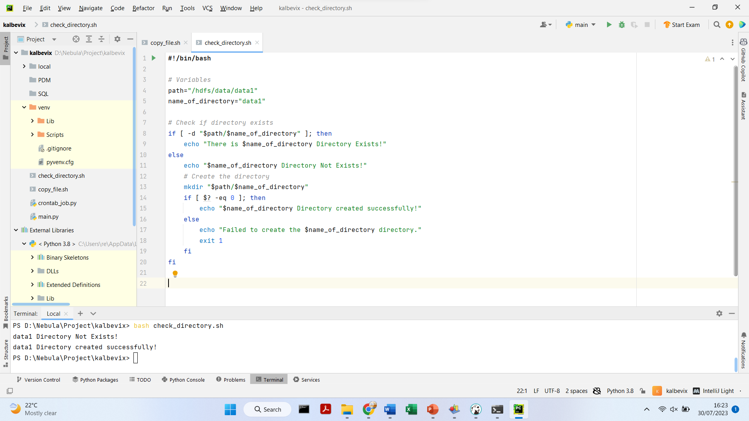
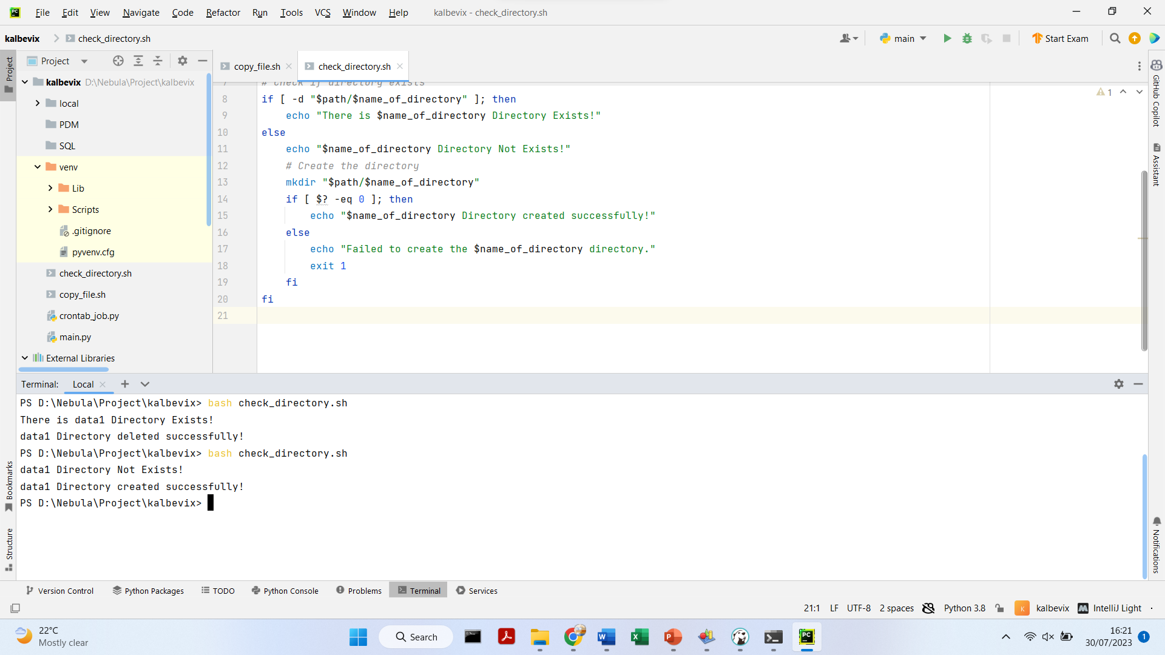
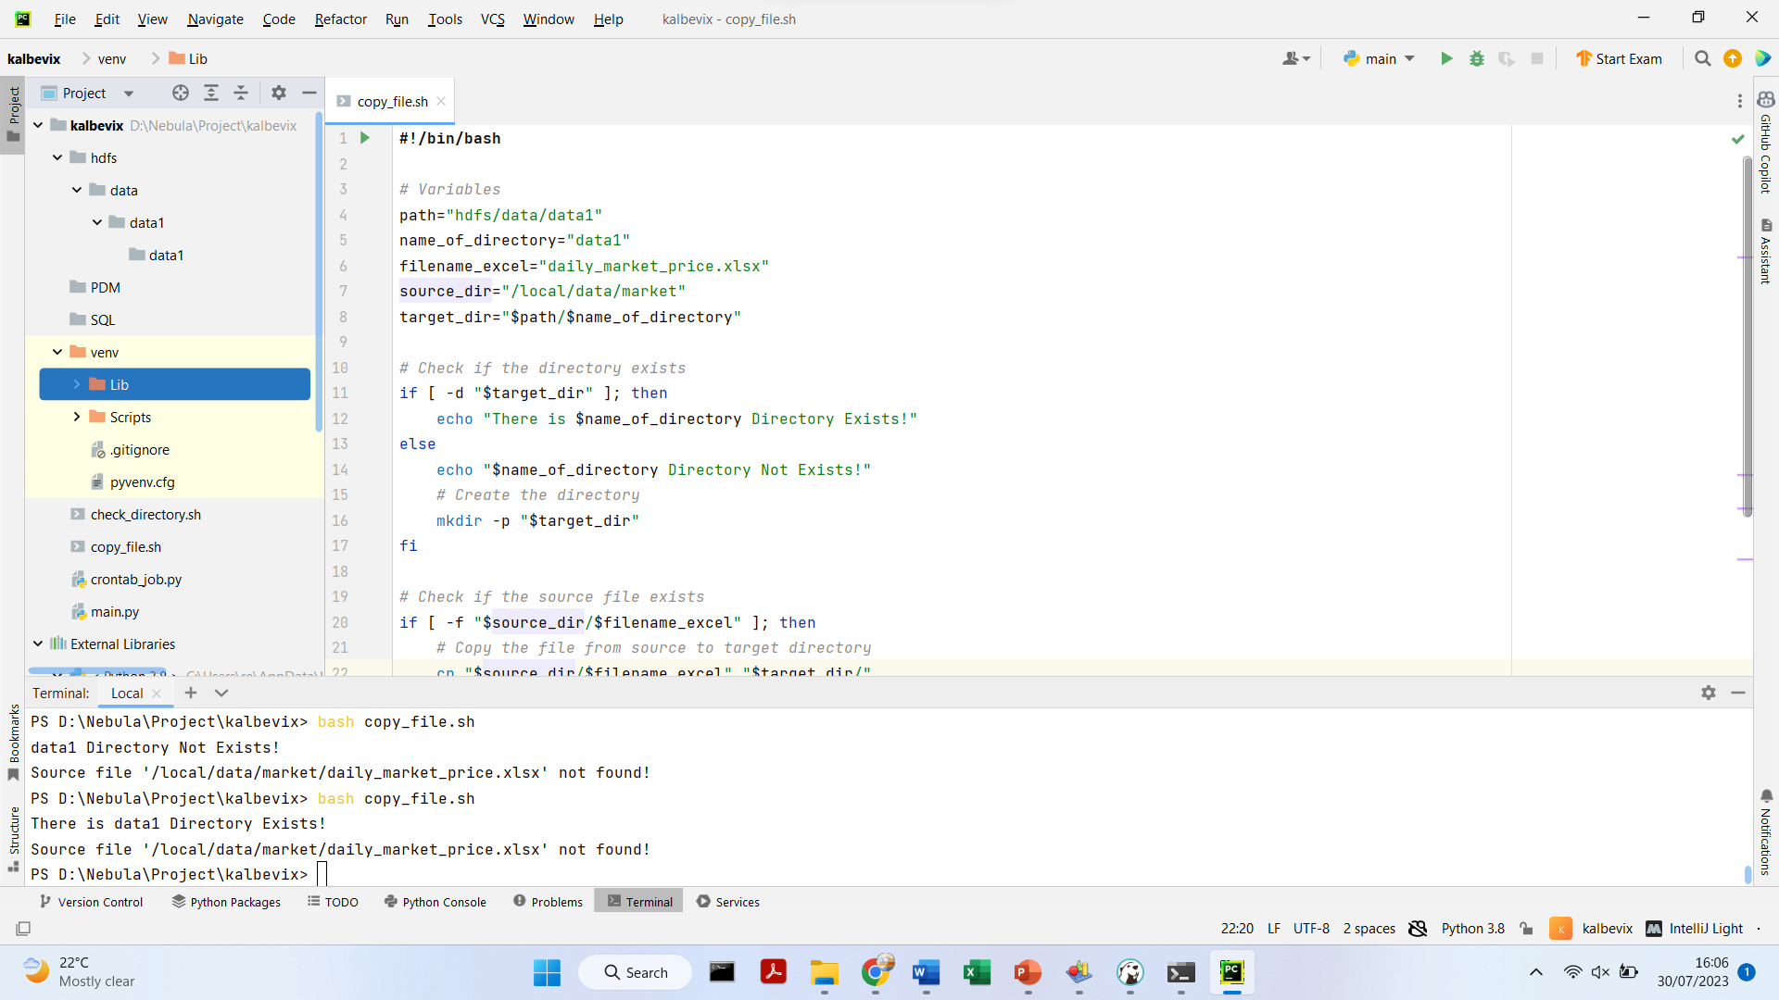
Challenge 1
Create the shell/bash script to check the existence of a directory and create it if it doesn't exist. The script is on the side.
Save the script in a file with a .sh extension as check_directory.sh.
Execute the script using bash command, ‘bash check_directory.sh’ in PyCharm Terminal.
Here’s the output

Slide 5
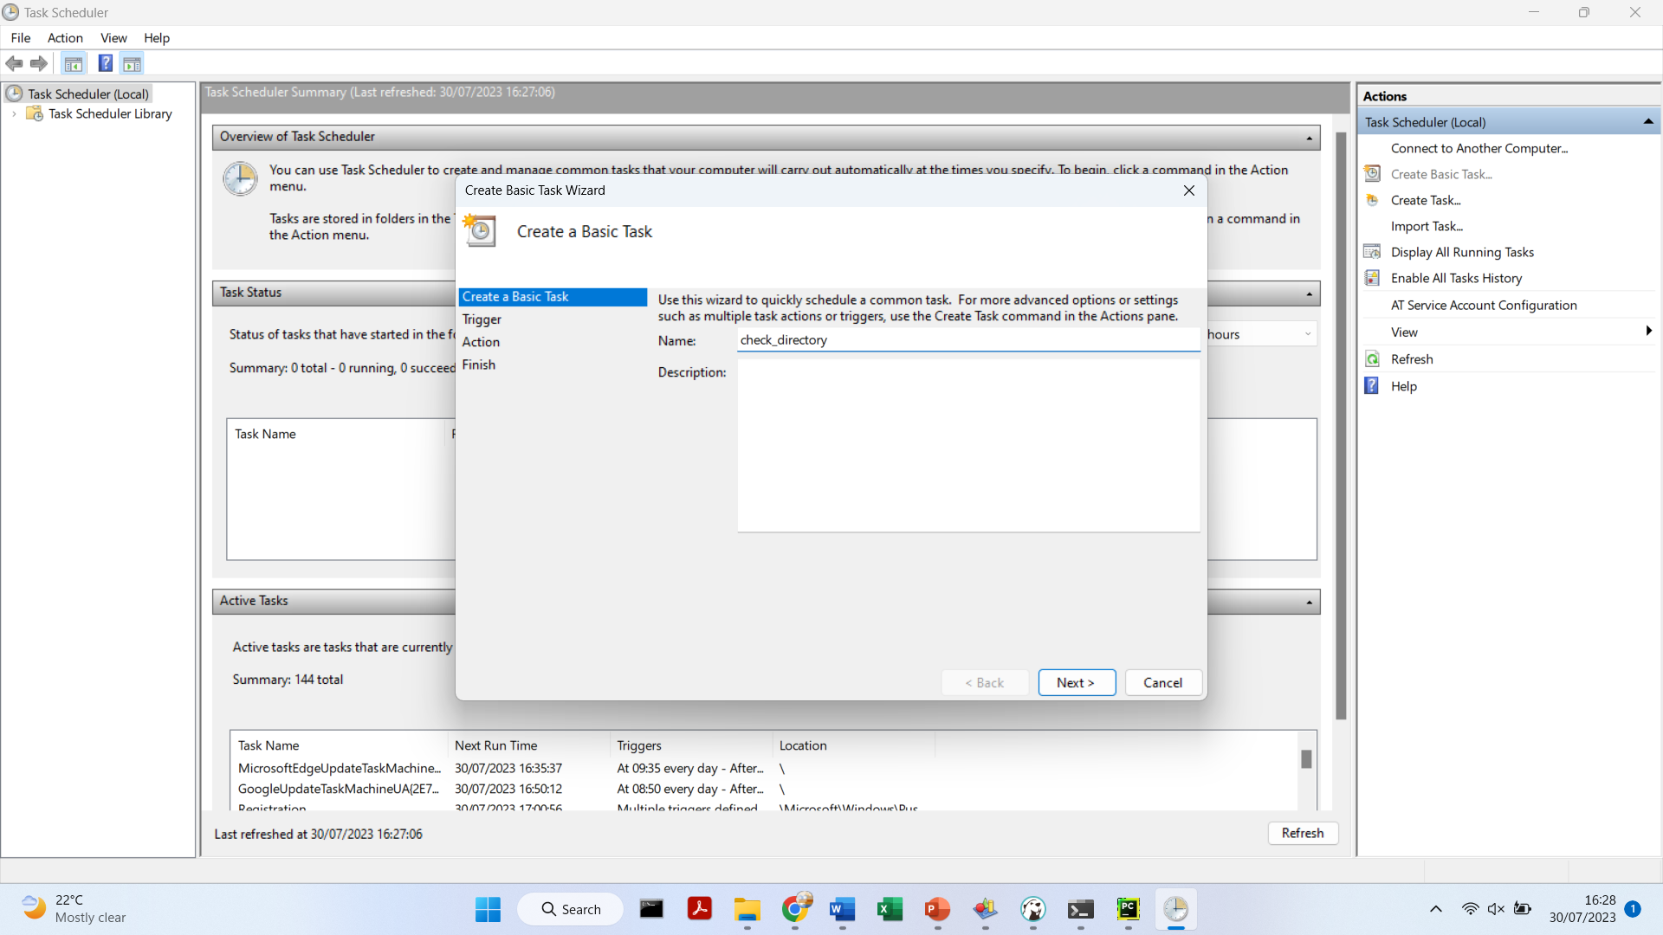
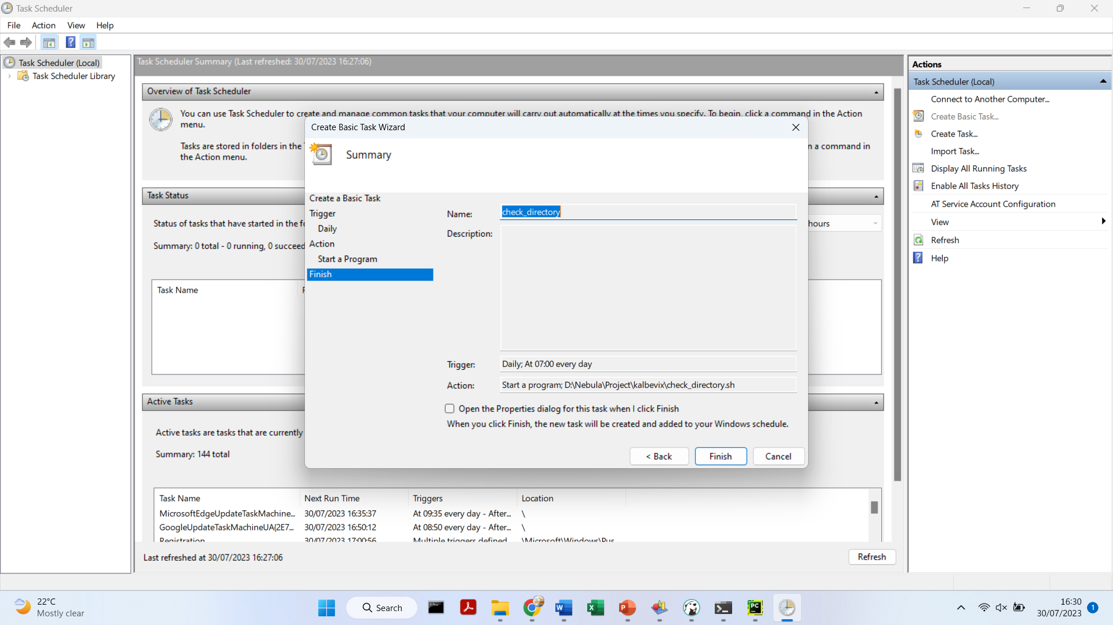
Challenge 1
Set up a crontab to run the script daily at 07:00 AM using Windows Task Scheduler.

Slide 6
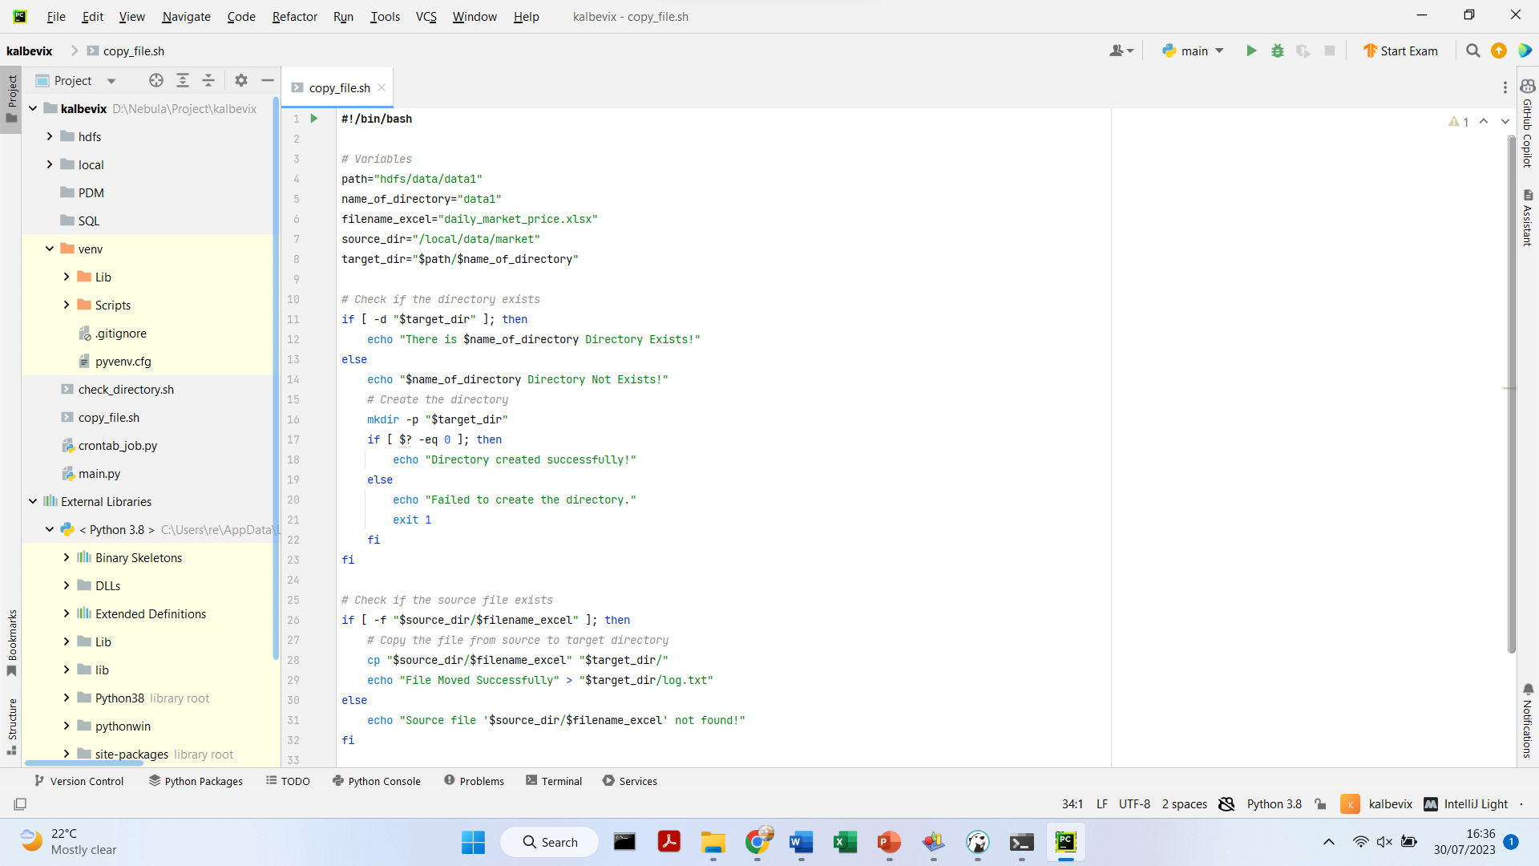
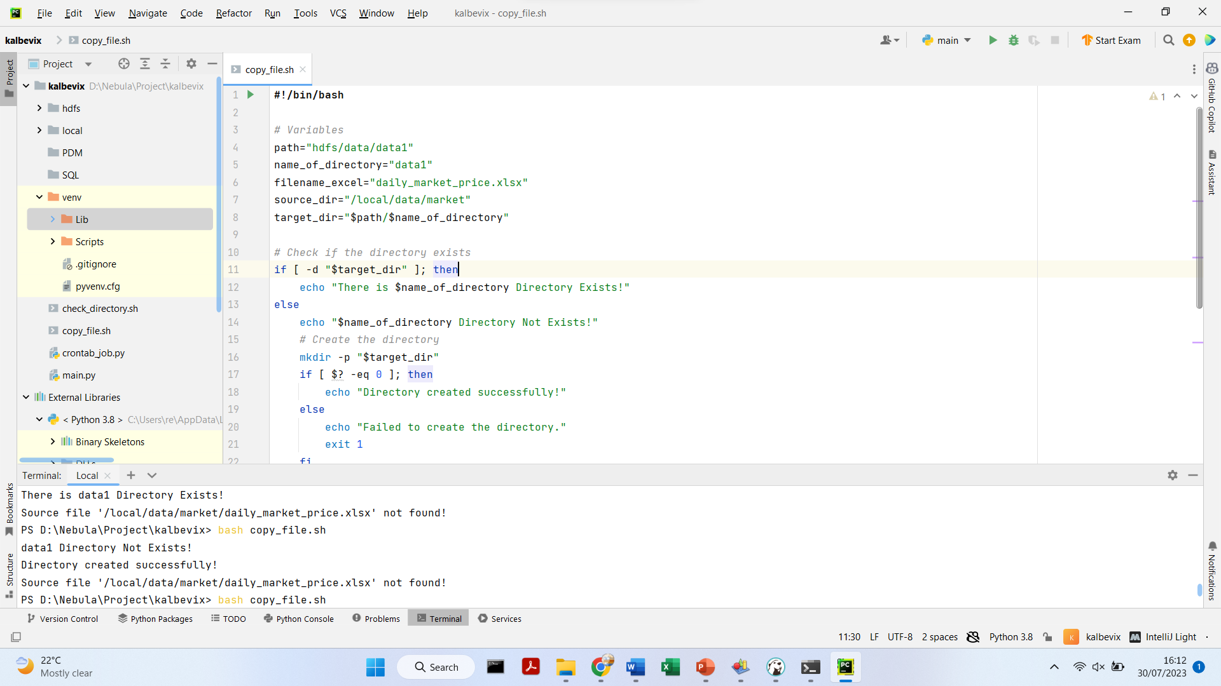
Challenge 2
Modify the shell/bash script check_directory.sh.
Add the new conditions to copy the file and create a log file. The script is on the side.
Save the modified script as copy_file.sh.
Run the script with ‘bash copy_file.sh’ in PyCharm Terminal.
Check the target directory to verify the results.

Slide 7
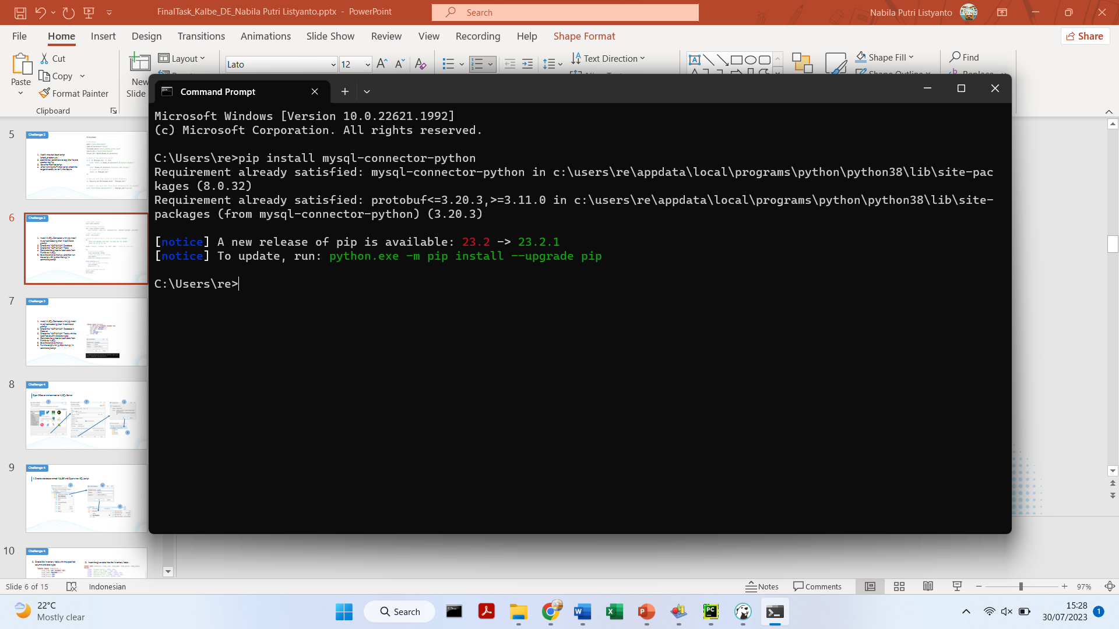
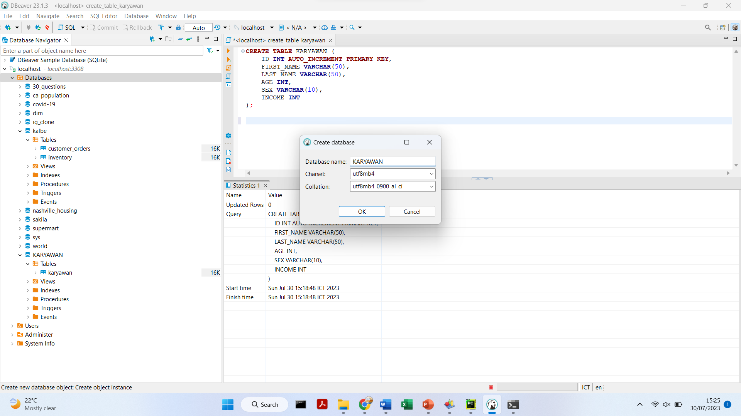
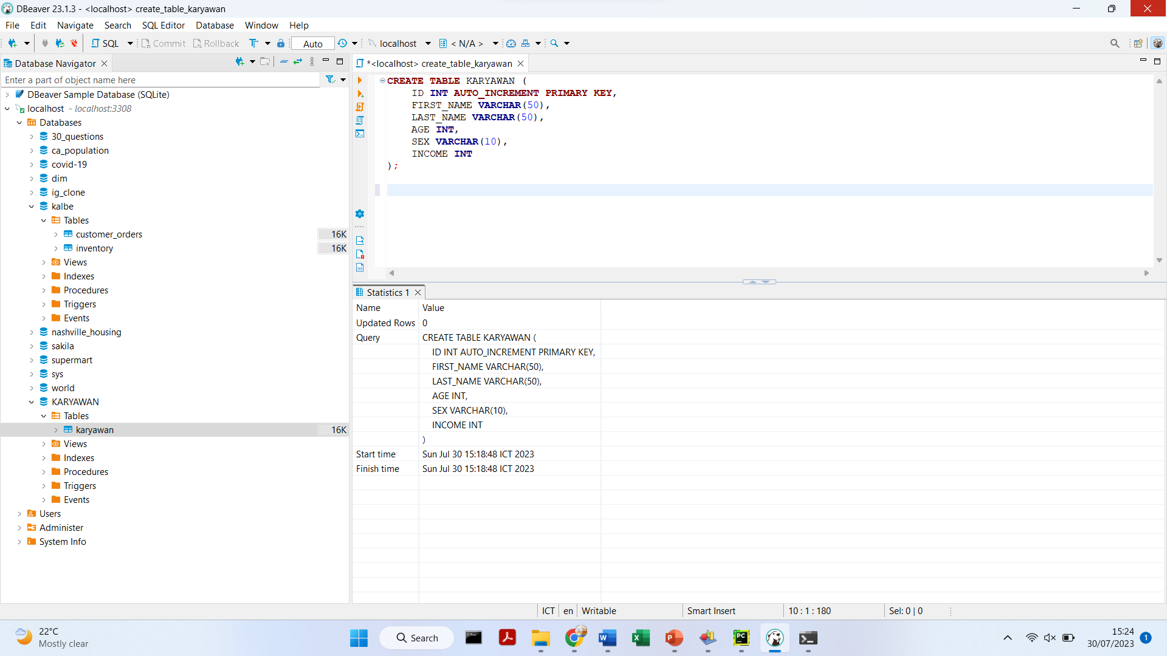
Challenge 3
Install MySQL Connector with ‘pip install mysql-connector-python’ in command prompt
Create the "KARYAWAN" database in Dbeaver
Create the "KARYAWAN" table with the specified column and data types

Slide 8
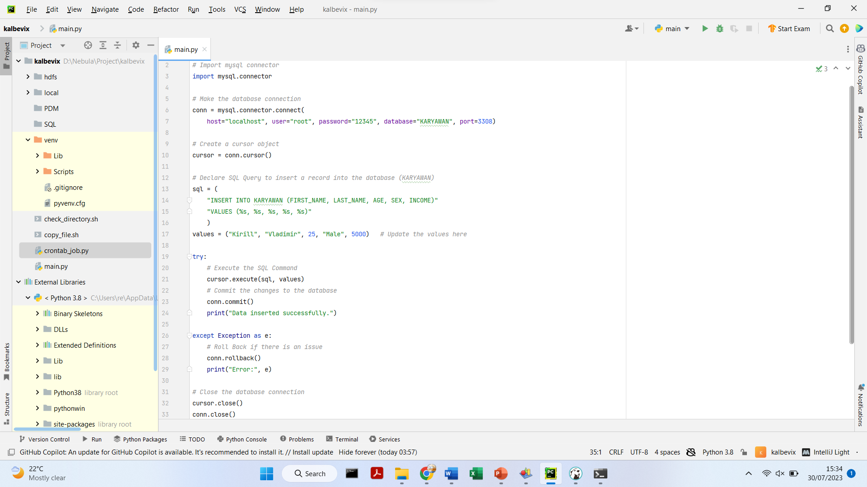
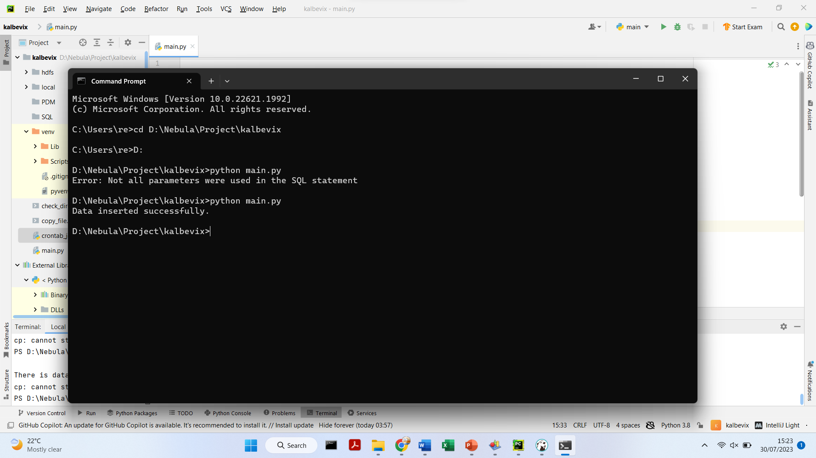
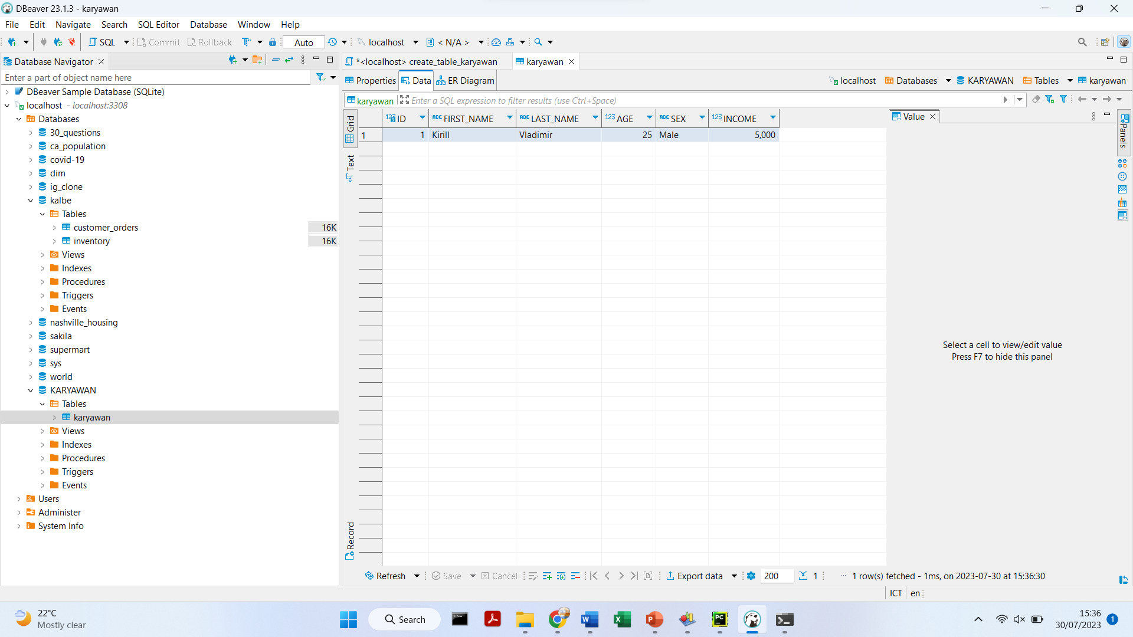
Challenge 3
Complete the syntax to insert data from Python to MySQL server. The script is on the side
Save the script as main.py. And then run the script with ‘python main.py’ in command prompt
Here’s the output

Slide 9
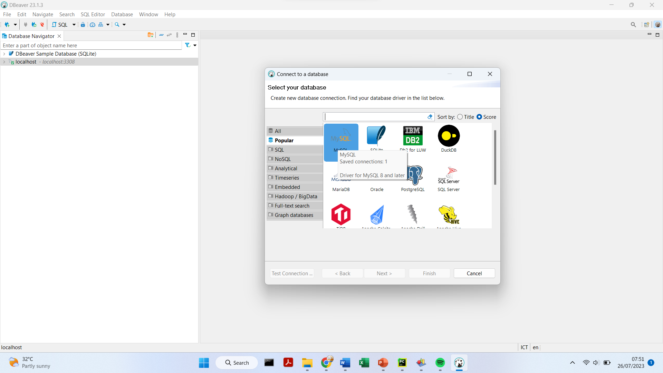
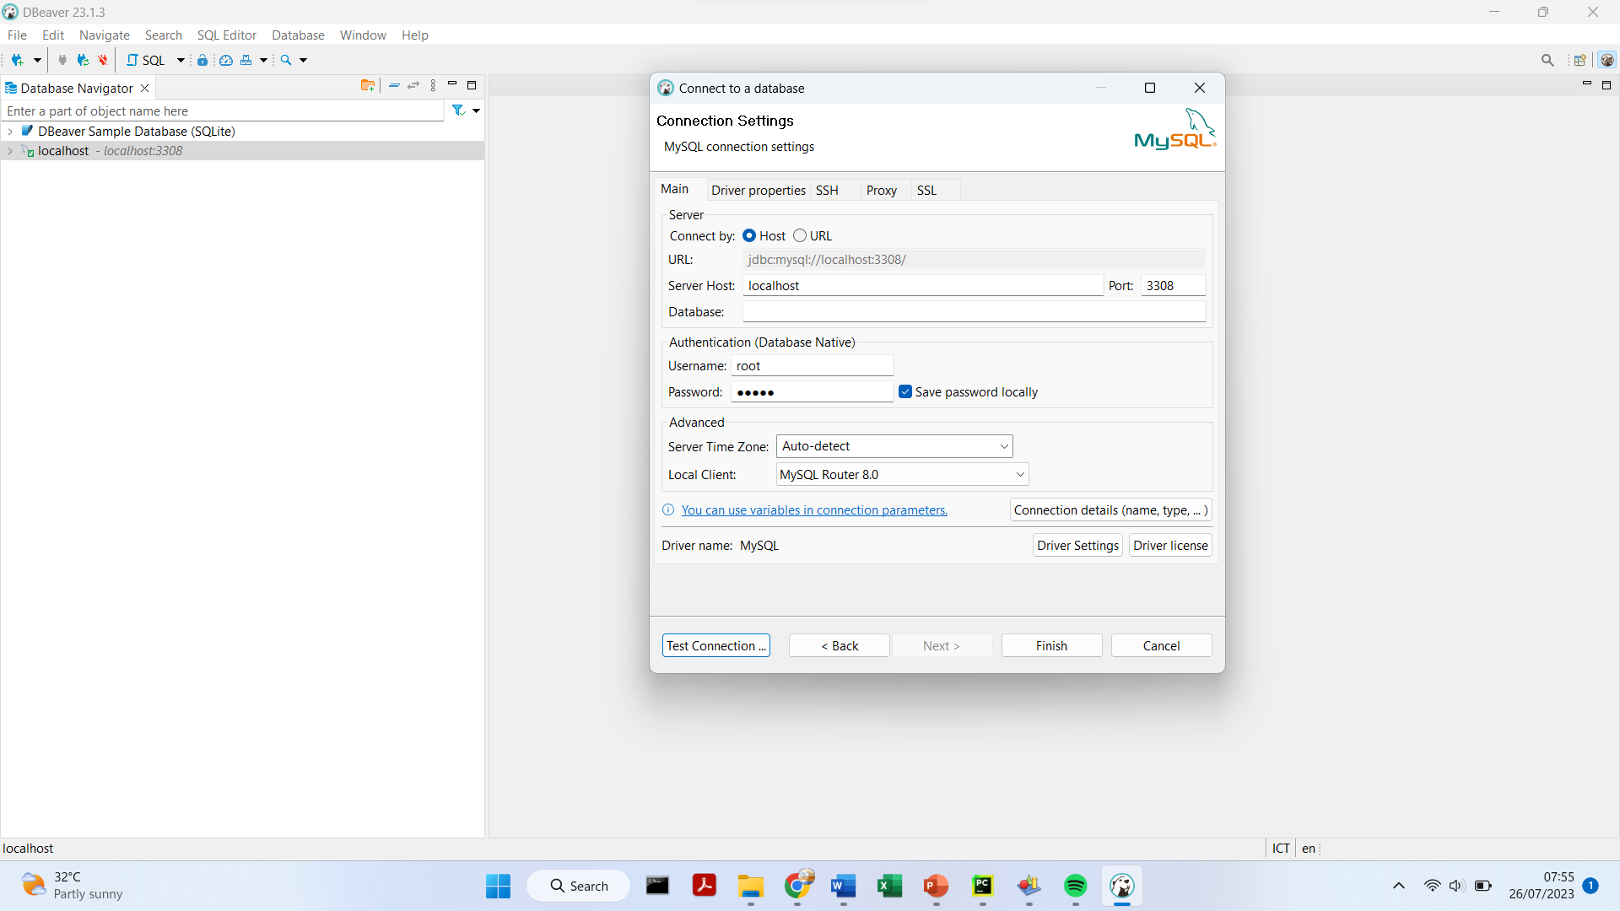
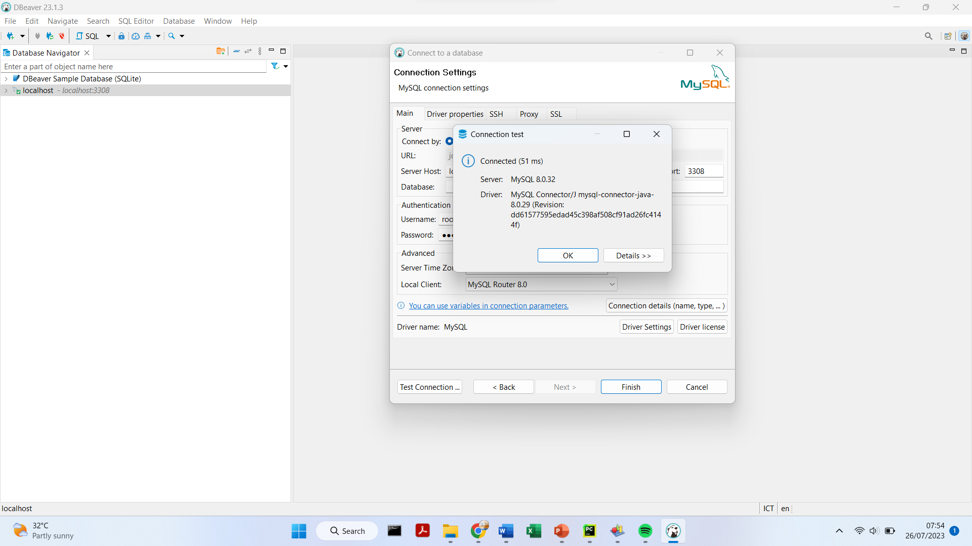
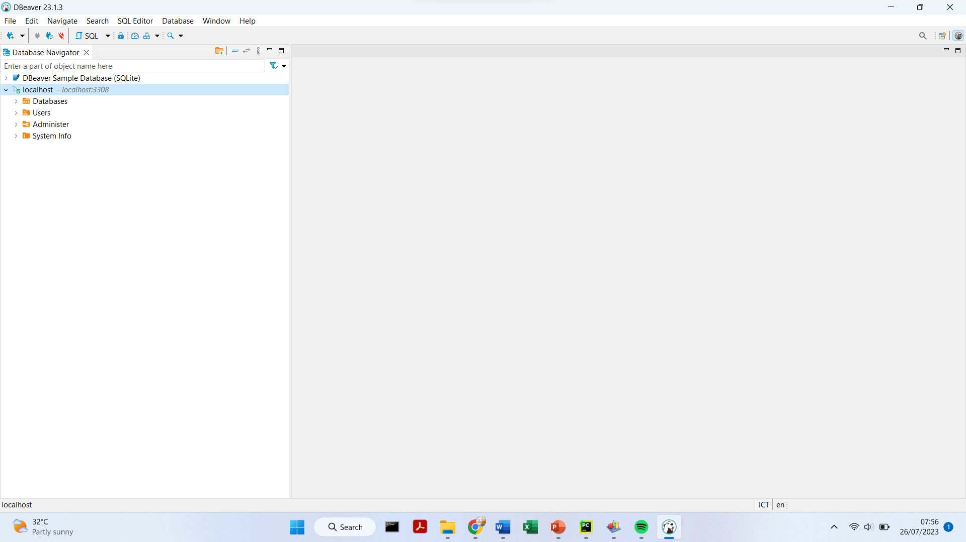
Challenge 4
Open DBeaver and connect to MySQL Server
1
2
3
4

Slide 10
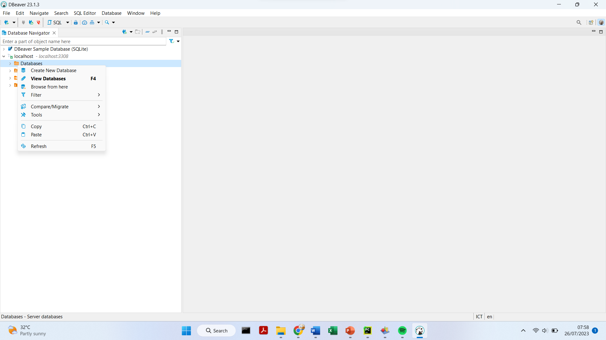
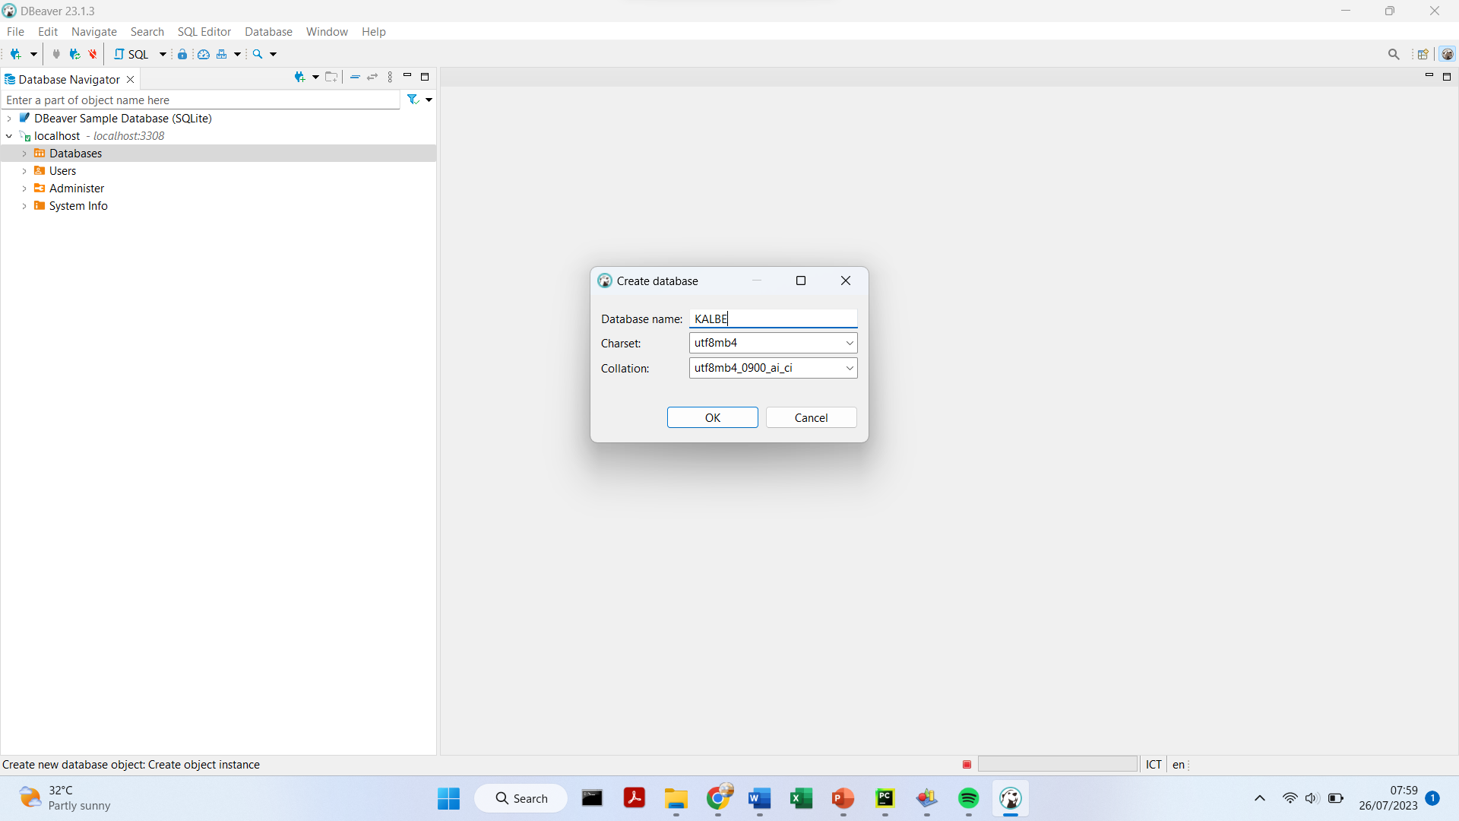
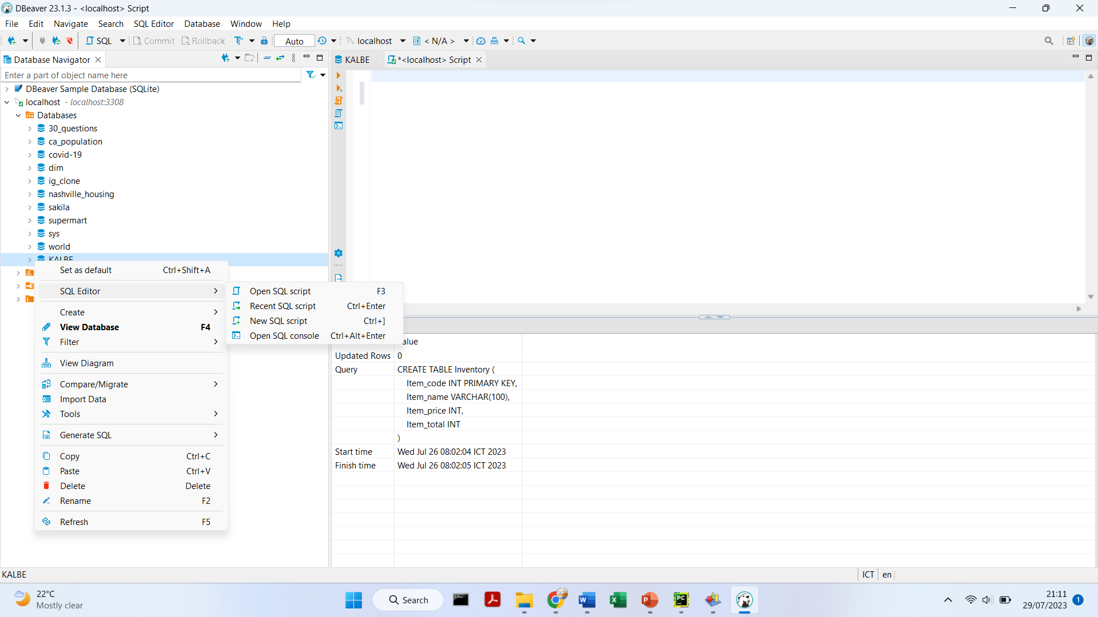
Challenge 4
1. Create a database named 'KALBE’ and Open a new SQL script
1
2
3

Slide 11
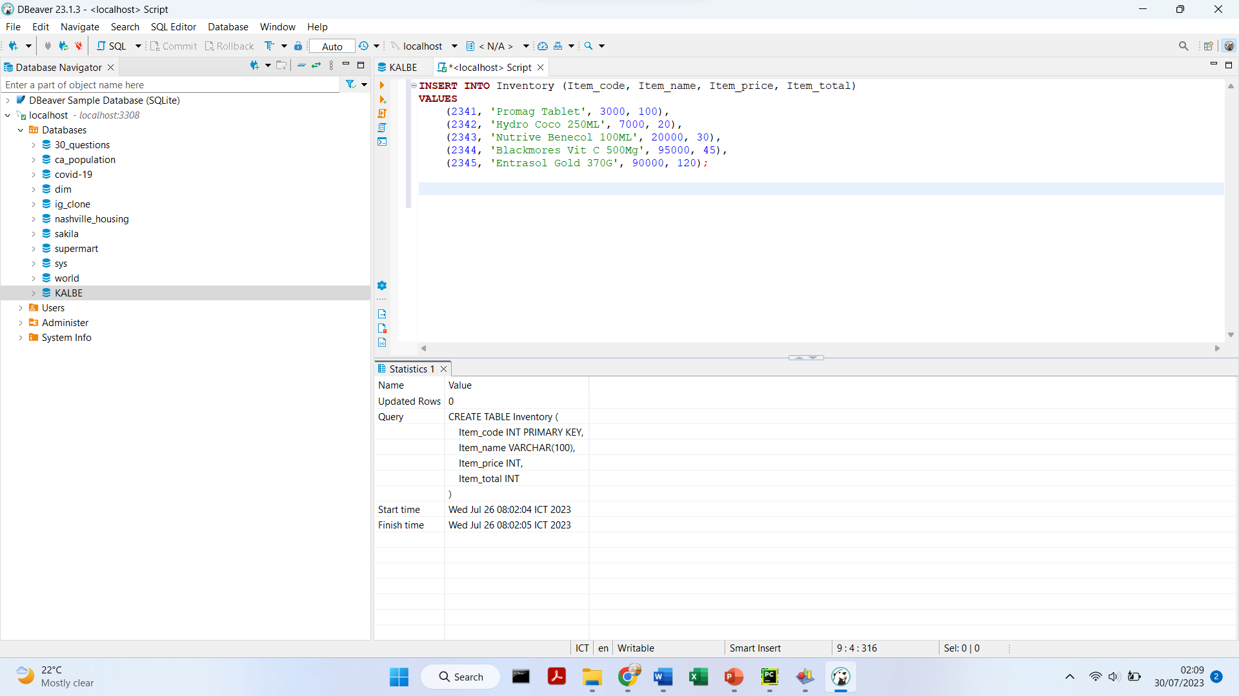
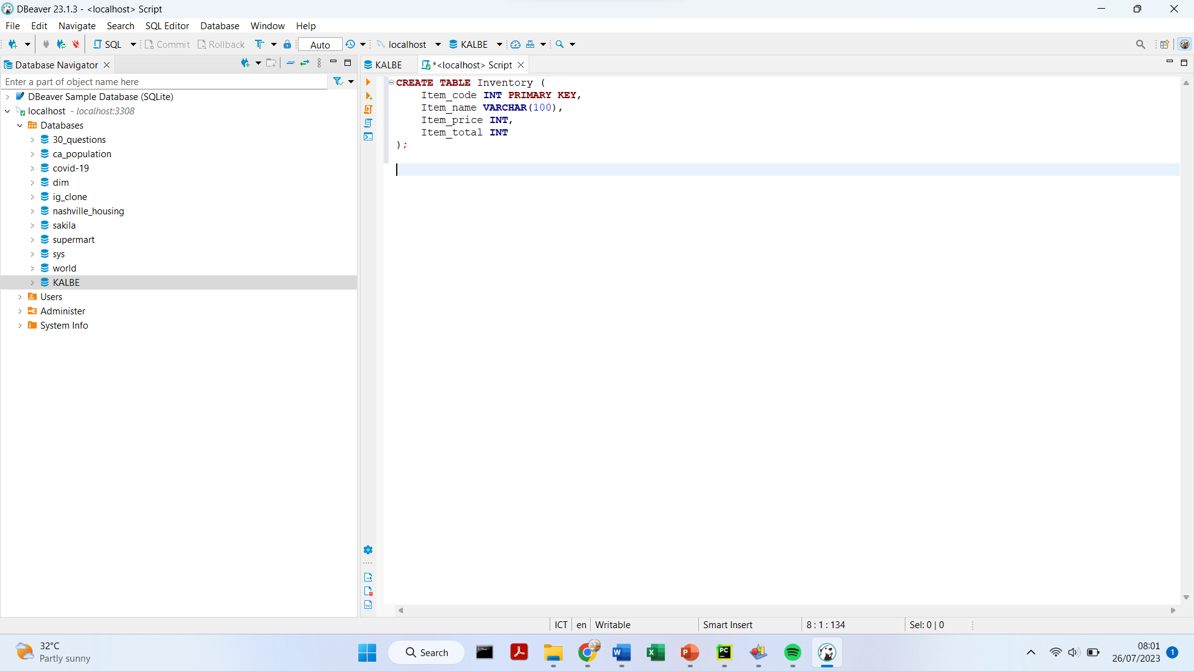
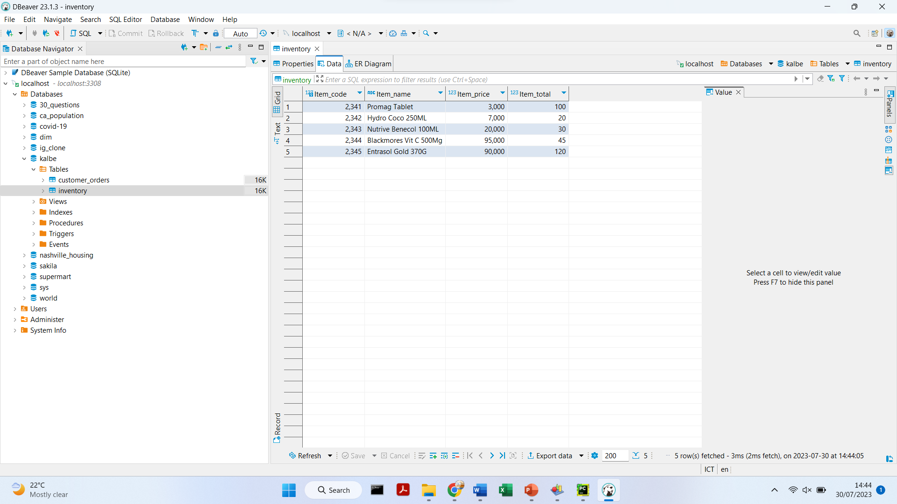
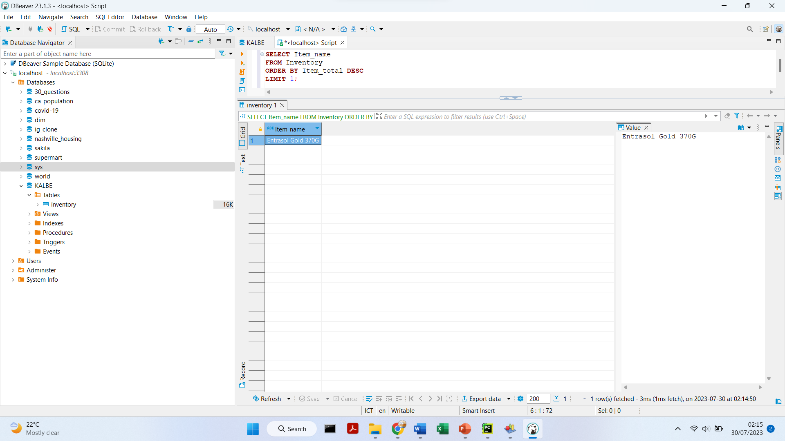
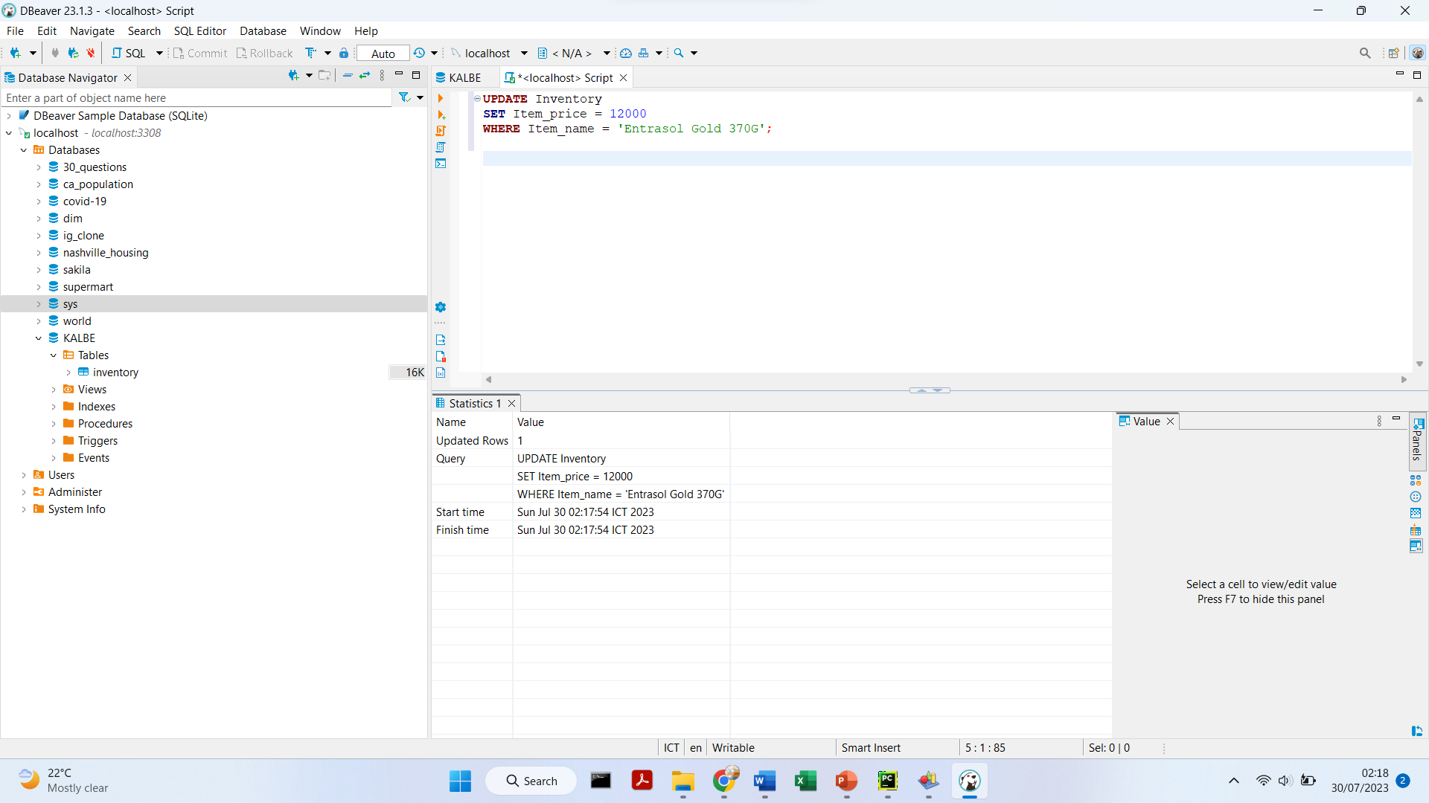
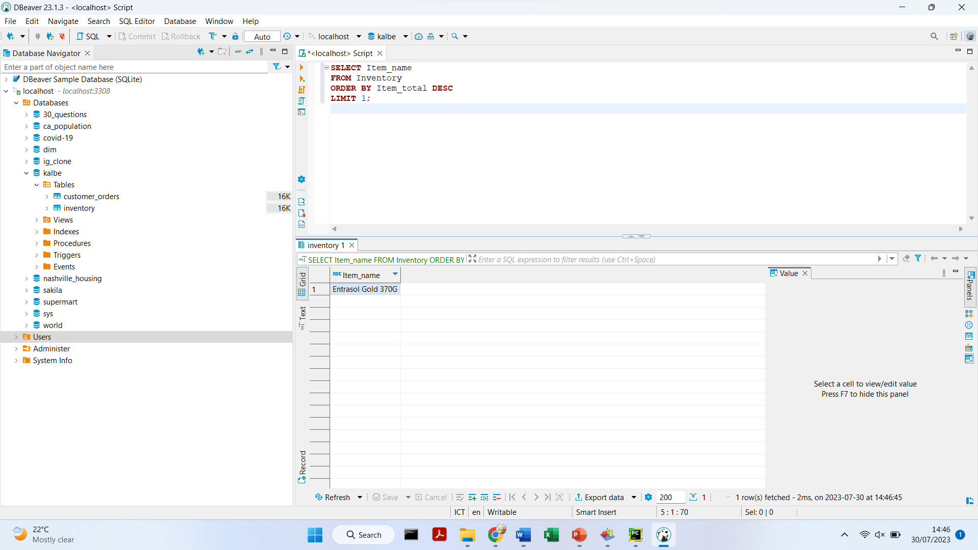
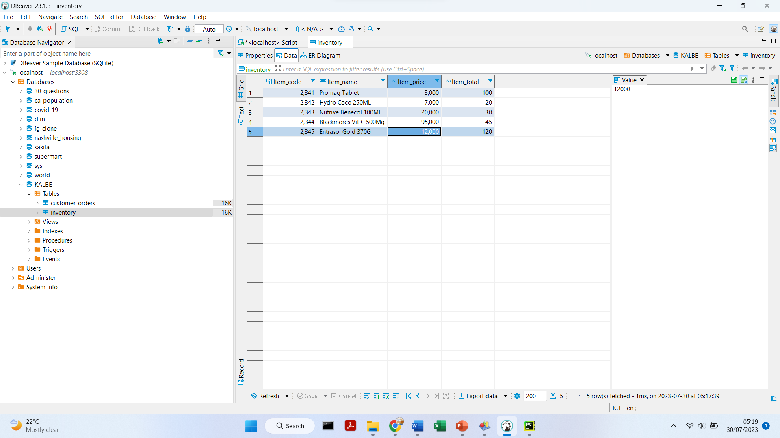
Challenge 4
Create the 'Inventory' table with the specified columns and data types
Insert the given data into the 'Inventory' table
4. Show Item_name with the highest Item_total
Update the Item_price of the output from the previous step

Slide 12
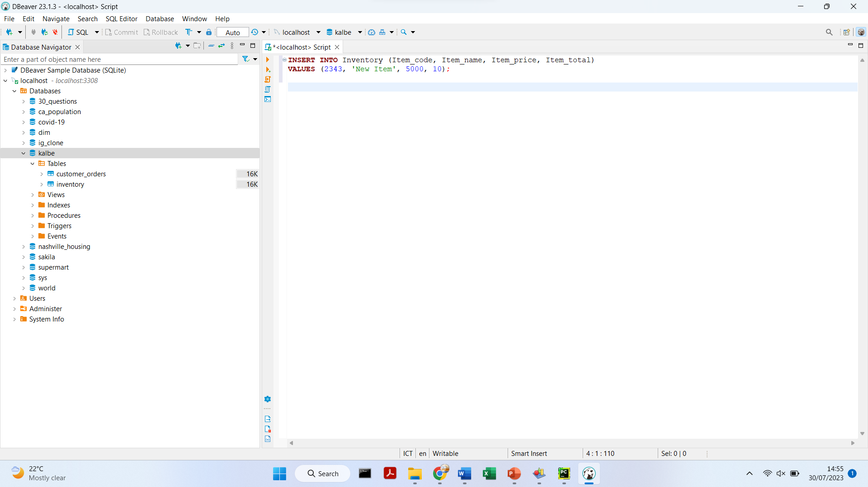
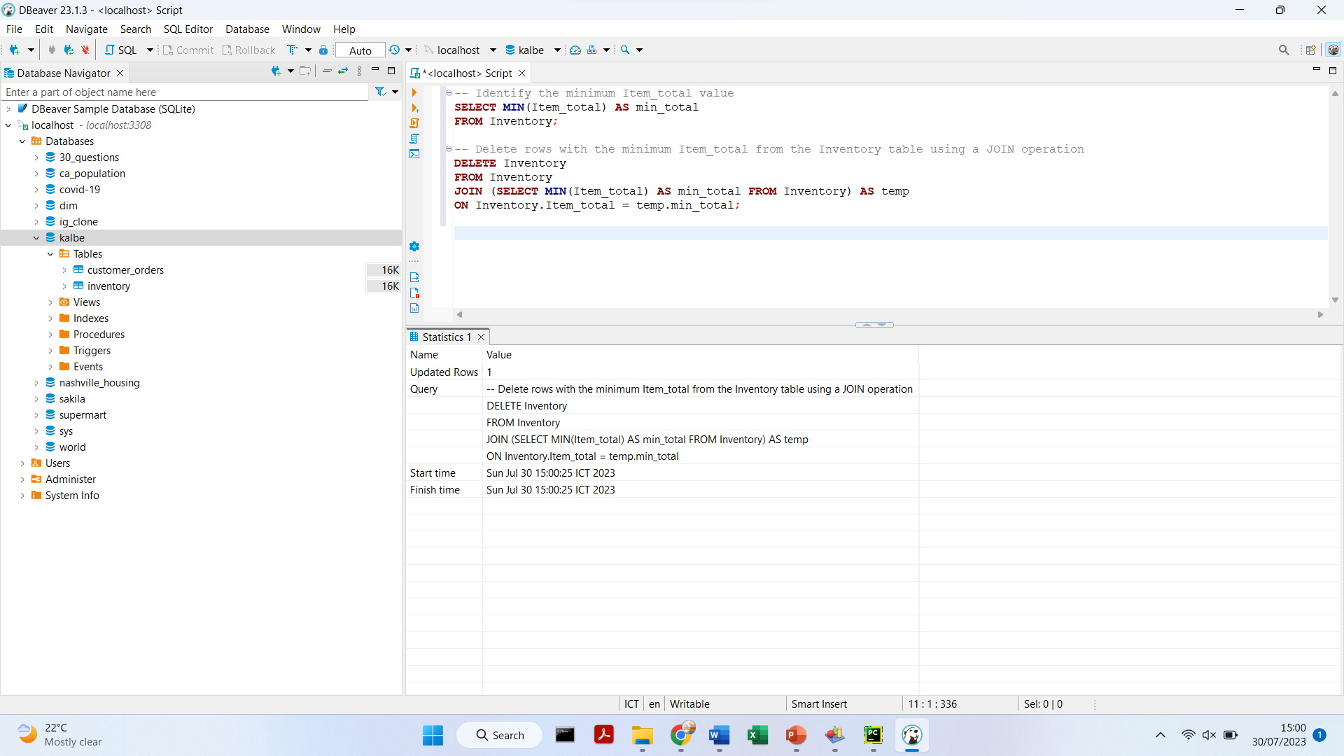
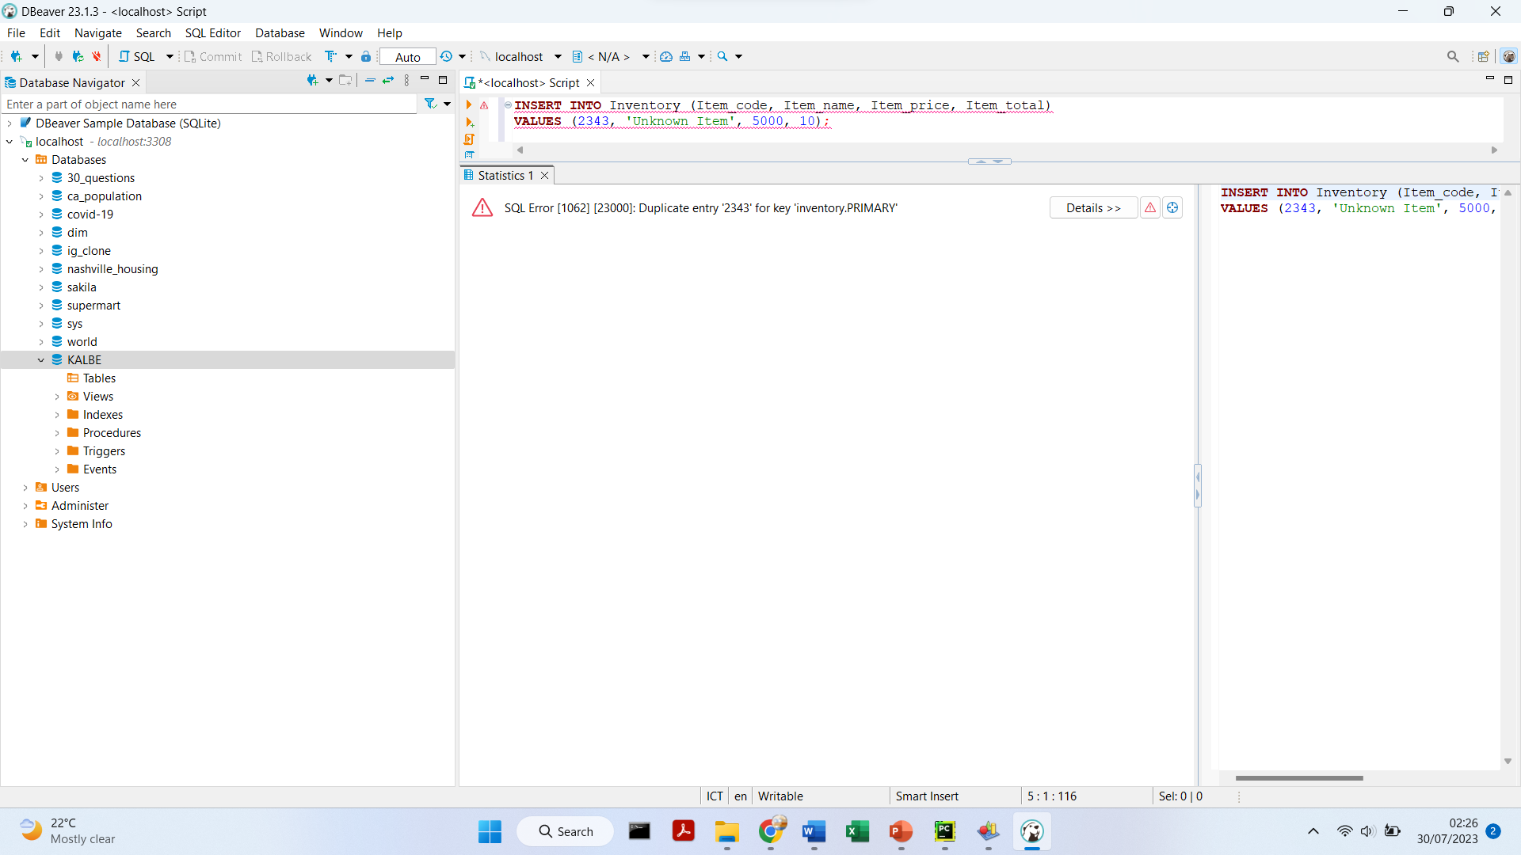
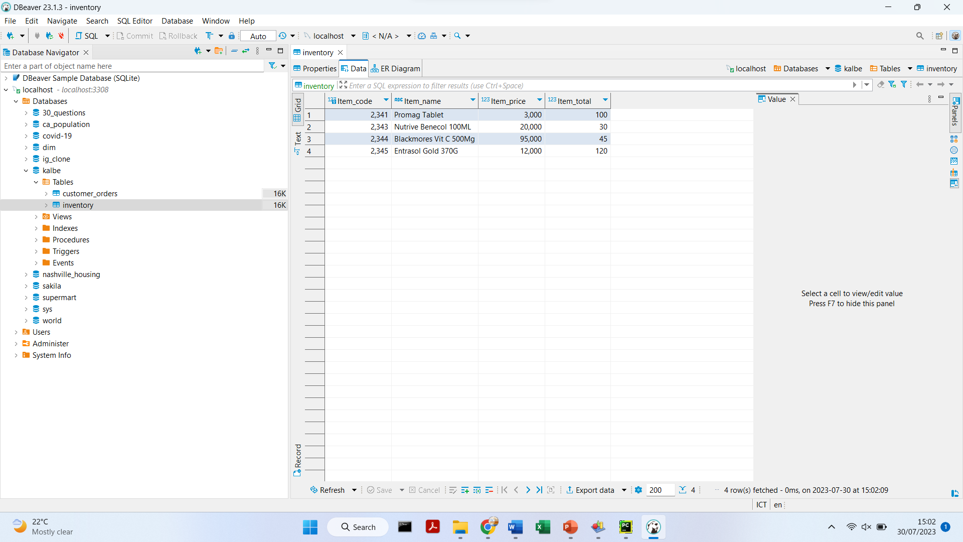
Challenge 4
6. Insert another Item_name with Item_code 2343
7. Deleting Item_name with the lowest Item_total using Join
Error:
When trying to insert another row with Item_code 2343 and a different Item_name into the table, it will result in a primary key violation because the Item_code column is set as the primary key, which must be unique for each row. Thus, the insertion will fail.

Slide 13
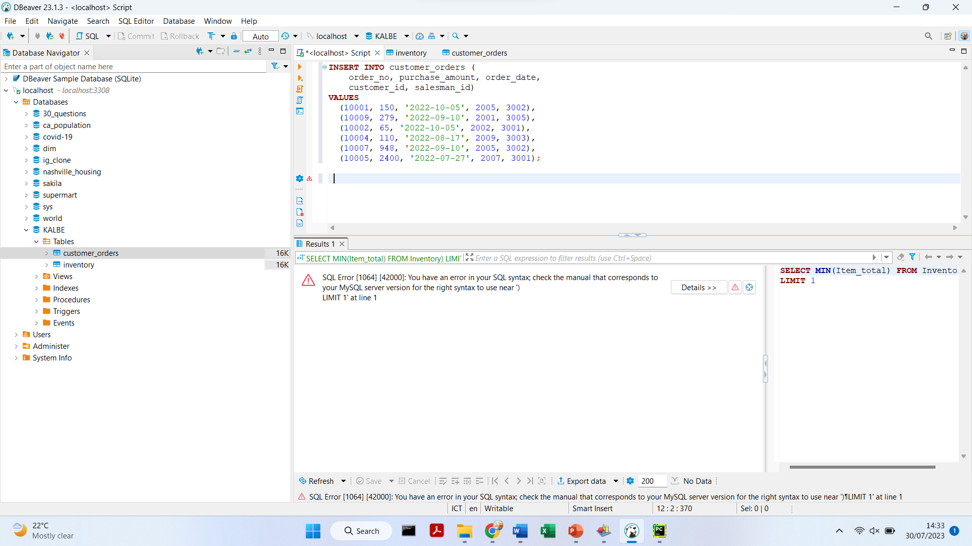
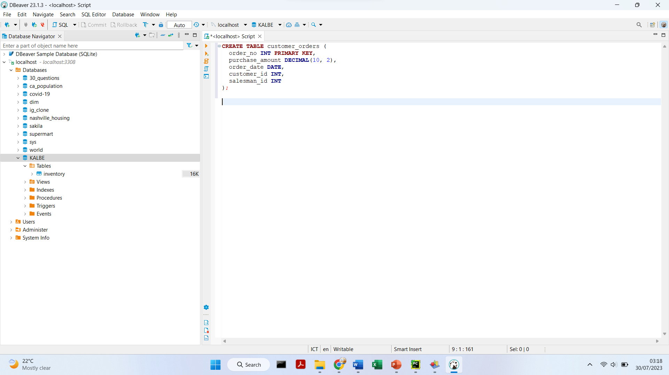
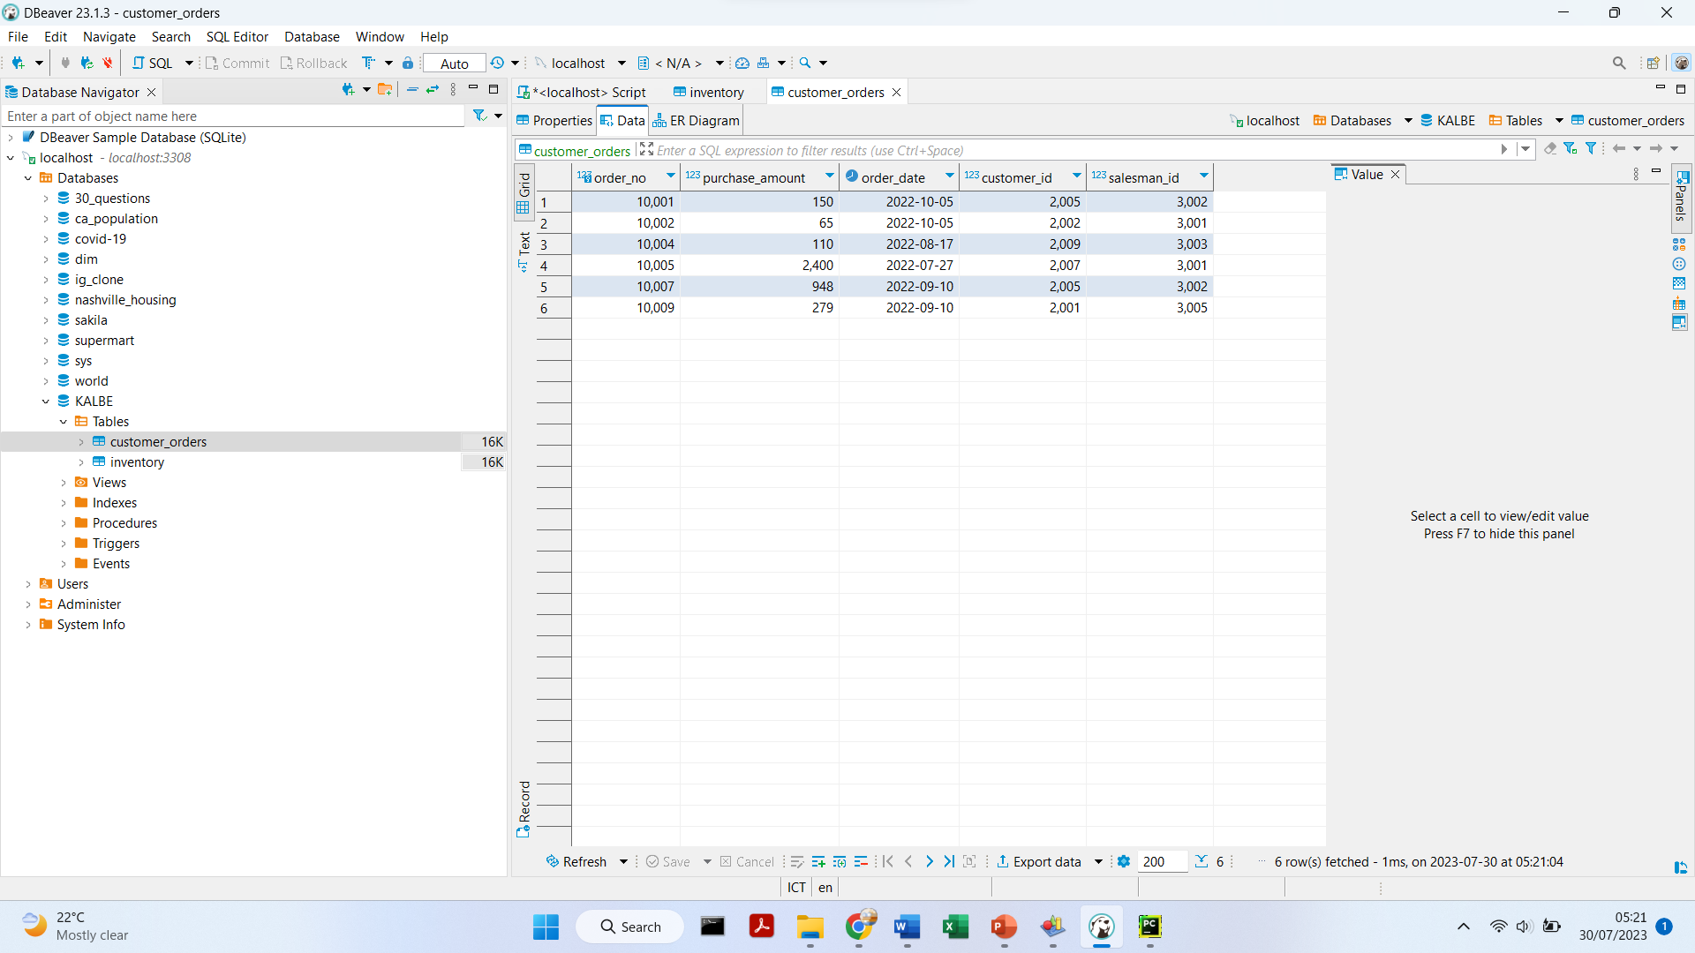
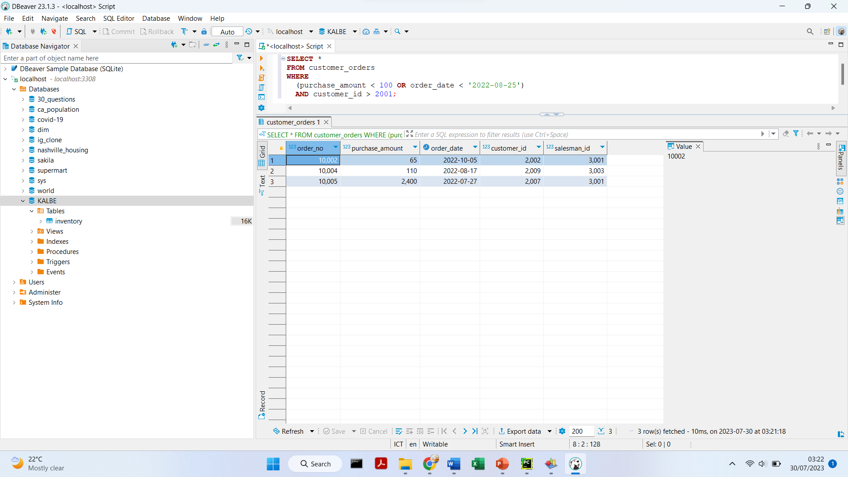
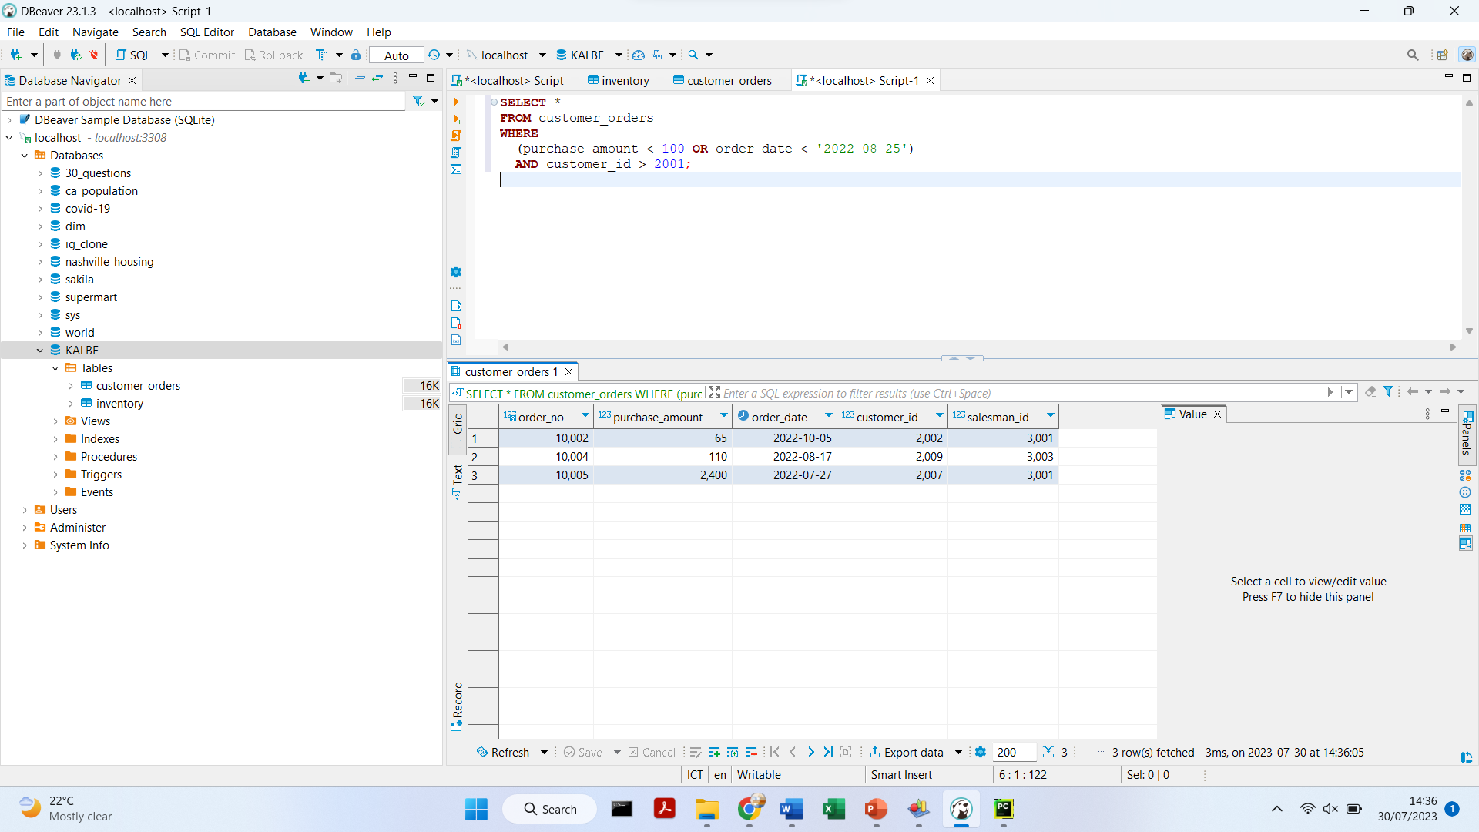
Challenge 5
Create the ‘customer_orders' table with the specified columns and data types
Insert the given data into the ‘customer_orders' table
Create a query to display all customer orders where purchase amount is less than 100 or exclude those orders which order date is on or greater than 25 Aug 2022 and customer id is above 2001

Slide 14
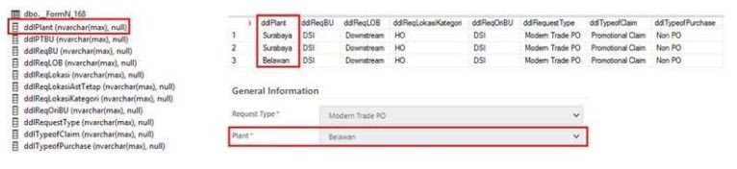
Challenge 6
Problem Statement
Based on the information provided, it seems that the field "ddlPlant" in the table "dbo.__FormN_168" contains duplicate city names like “Surabaya, Surabaya, Belawan." Having duplicate values in this field can lead to problems like data integrity issues, data inconsistency, incorrect results in queries, and difficulties in data maintenance.
Solution
The best solution for this case would be to normalize the data and remove duplicates from the "ddlPlant" field. Additionally, in this case may benefit from indexing and other optimization techniques to improve query performance, and enforcing a unique constraint to ensure data integrity.

Slide 15
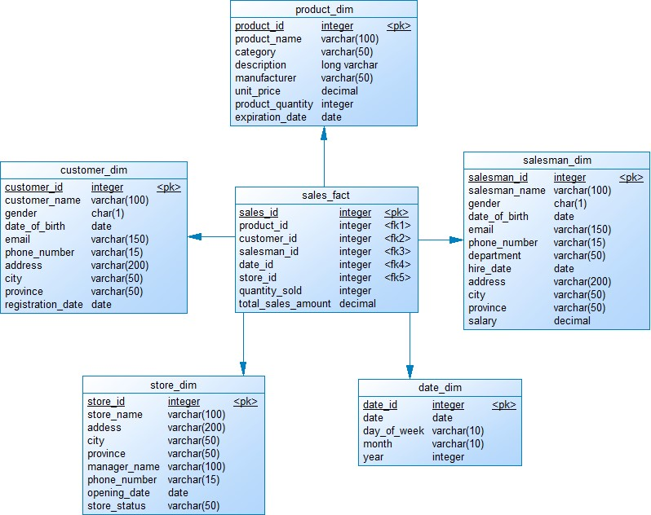
Challenge 7
Create a simple star schema for KALBE database consists of 1 Fact and 5 Dimensions using Physical Data Model Theory.

Slide 16
THANK YOU!
Contact me:
https://www.linkedin.com/in/nabila-putri-listyanto/
Link project:
https://github.com/ilutysn/VIX_Kalbe_DE
Link video:
https://youtu.be/0ErYAZFKLeQ

